Slide 1
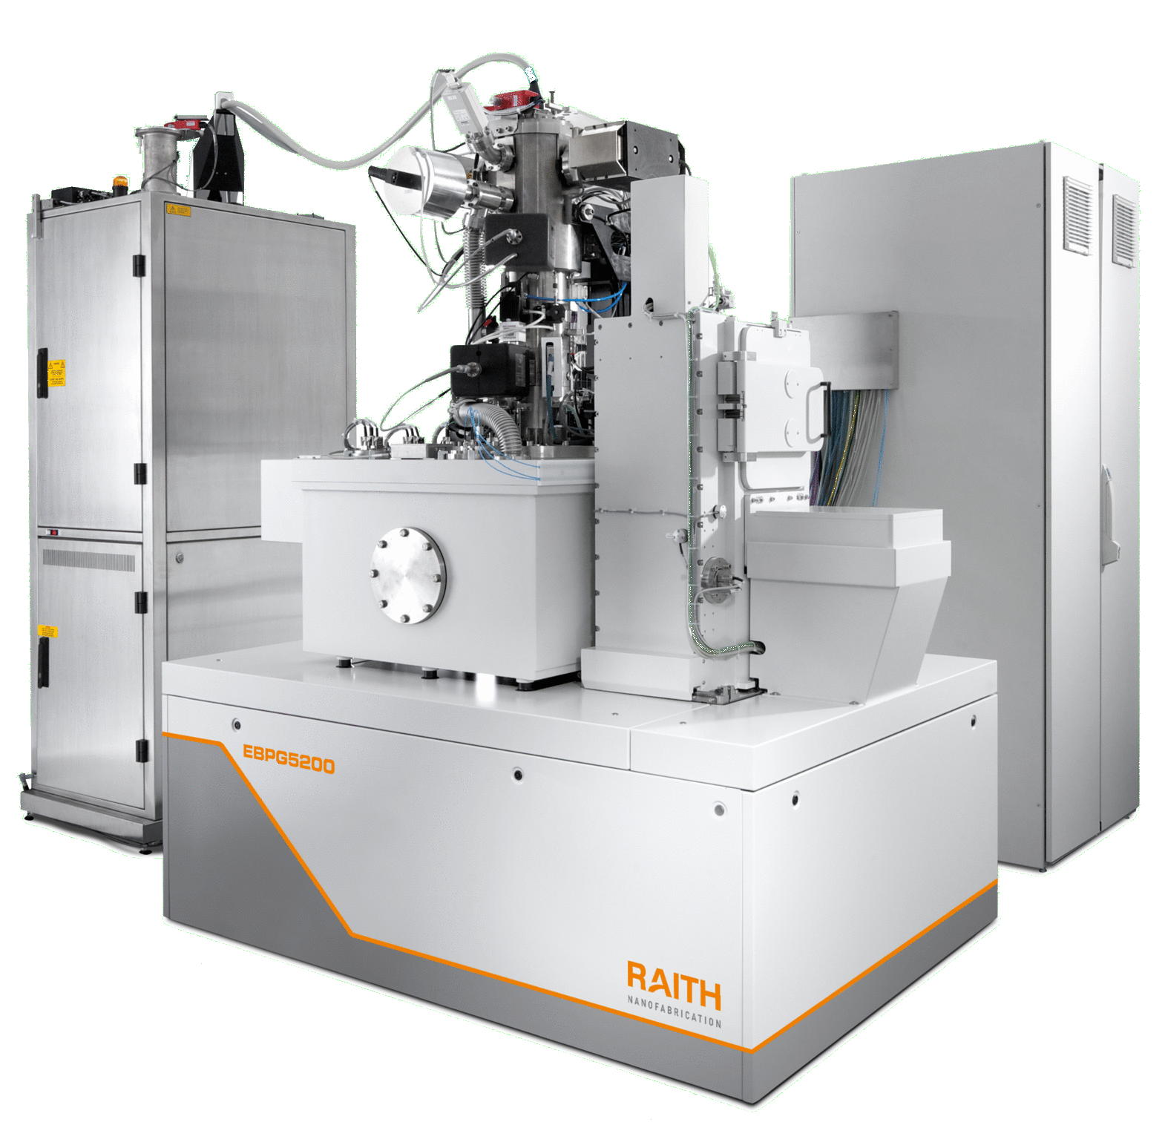
Description
The EBPG is a high-performance electron beam lithography system with 50kV / 100 kV write modes and high-resolution lithography below 5 nm. The EBPG offers the unique combination of a powerful and stable beam with up to 350 nA beam current and fully automated calibration and alignment procedures. In conjunction with BEAMER software (GenISys GmbH), the system provides advanced fracturing capabilities and very short writing times.
Specifications / Capabilities
Wafer size : Up to 5in wafers Maximum Field size: 1mm Overlay accuracy : <30nm Stitching accuracy : <40 nm Beam Current Up to: 350nA
Raith EBPG 5150 Electron Beam Lithography
Nano-Fabrication
Center
Link
https://www.raith.com https://www.genisys-gmbh.com/

