Slide 1
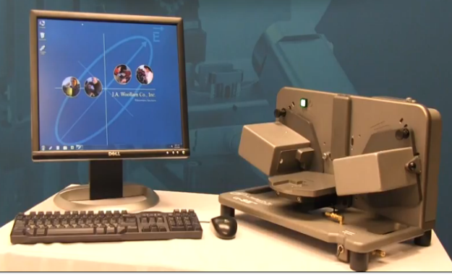
Woollam alpha-SE® Ellipsometerl
Description
Using for routine measurements of thin film thickness and refractive index for one- and multi-layer structures. This ellipsometer allows to mount a sample, choose the model that matches your film and press "measure" to get results. Phase information of a spectroscopic ellipsometry measurement is highly sensitive to very thin films (<10nm). Single-layer dielectrics on silicon or glass substrates can be measured in seconds. Also can be measured: Oxides on Si; Transparent thin films; Glass substrate; Metal substrates; Organic monolayers on Gold; Absorbing thin films; Multilayers; etc.
Specifications / Capabilities
Spectral range - 380nm to 900nm, 180 wavelengths Angle of incidence - 65, 70, or 90 degree (straight - through) Data Acquisition rate - 3 sec., 10sec. and 30 sec. for high precision mode. Spot size - 3mm
Link
http://www.jawoollam.com/alphase_home.html
Nano-Fabrication
Center

