Slide 1
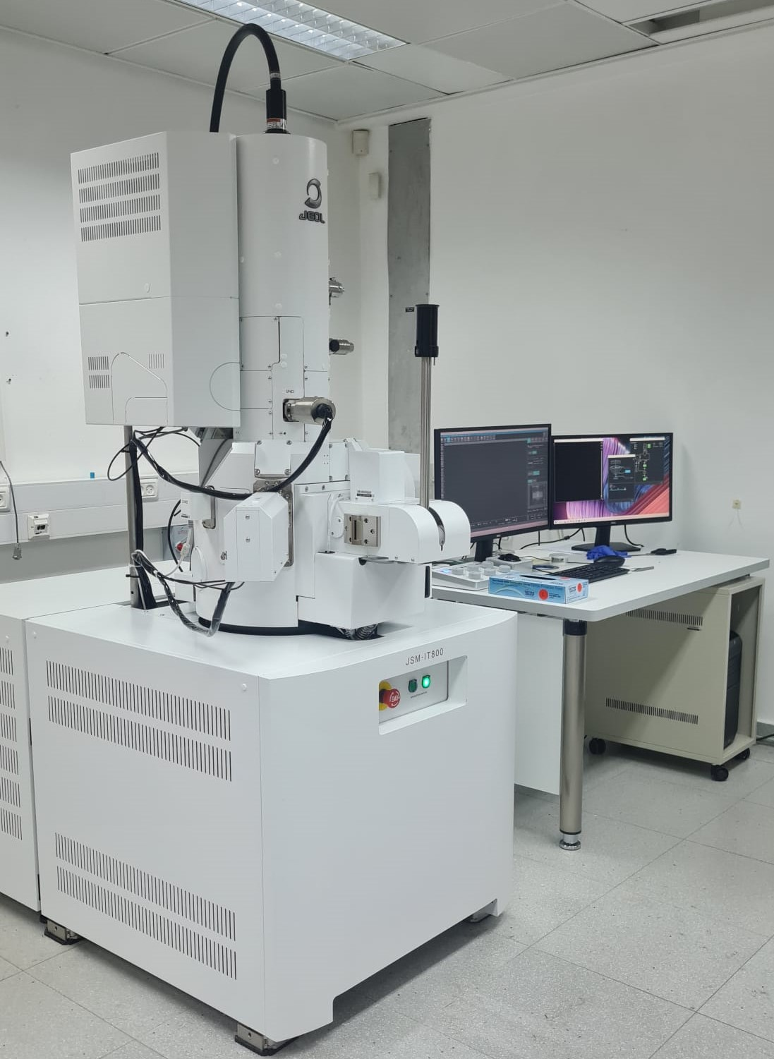

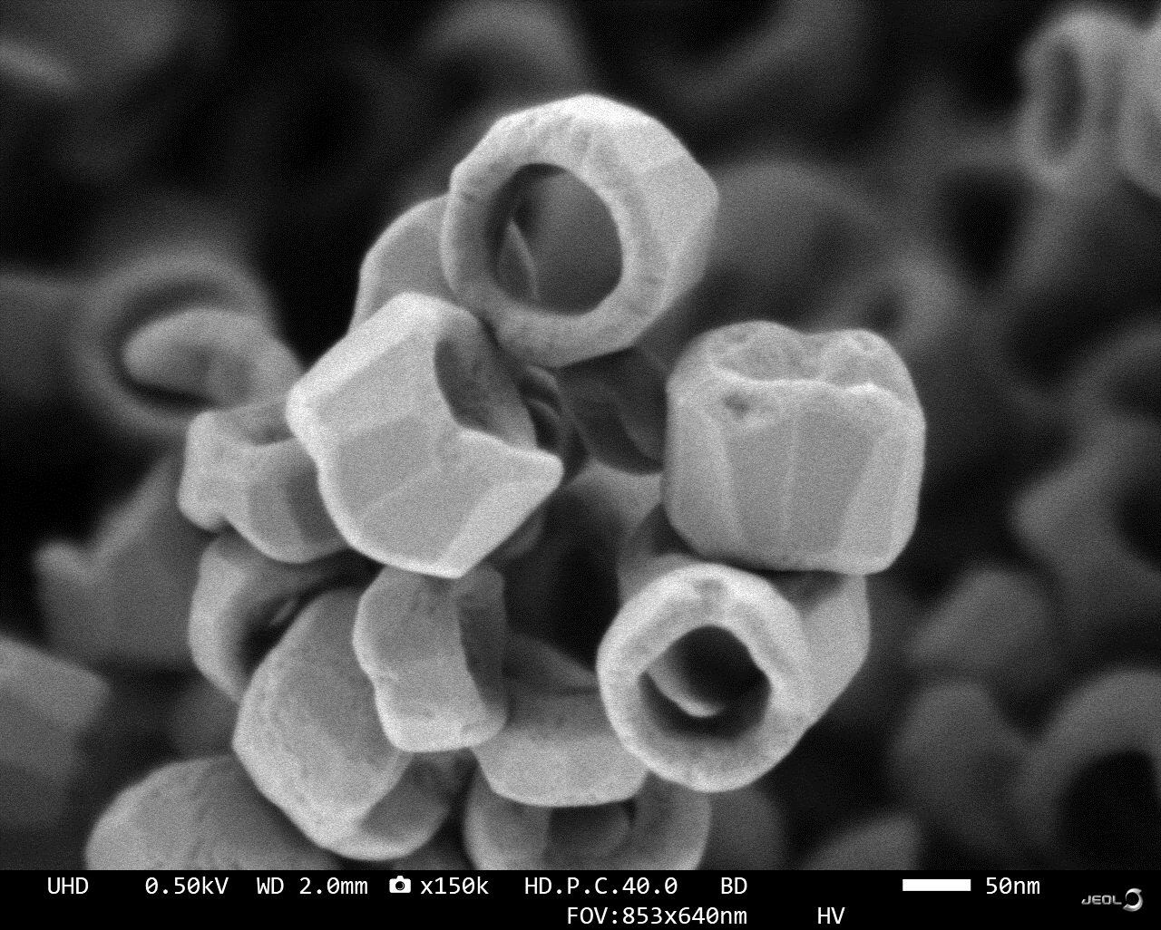
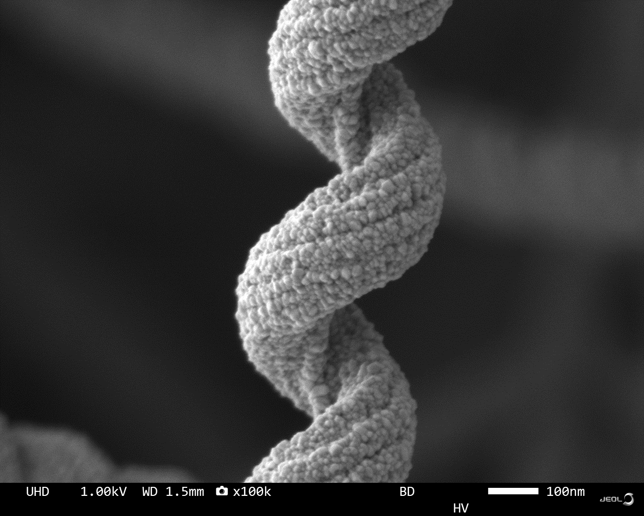
JEOL JSM-IT800 SHLs
Schottky Field Emission SEM
Description
The JSM-IT800 SHLs by JEOL is a state-of-the-art Schottky Field Emission Scanning Electron Microscope (SEM) designed for high-resolution imaging and advanced material analysis. This cutting-edge system is equipped with multiple detectors to support diverse applications. The SED (Secondary Electron Detector) captures high-resolution surface morphology. The Upper Hybrid Detector (In-Lens) provides superior imaging of surface features by combining secondary and backscattered electron signals. The SBED (Scintillator Backscattered Electron Detector) enables material contrast imaging and compositional analysis by detecting backscattered electrons with high sensitivity. Additionally, the system is equipped with EDS (Energy Dispersive X-ray Spectroscopy), which facilitates precise elemental analysis and mapping for a wide range of materials.
Specifications/Capabilities
Schottky Field Emission Electron Source. Resolution of 1.1nm at 1kV and 0.6nm at 15kV Maximum Specimen size: Diam. 200 mm, Height: 55 mm. Detectors: SED,SBED,UHD,EDS. Movement range: X: 100 mm Y: 100 mm Z: 1 to 50 mm. Tilt: -5 to 70° Maximum Probe current 500 nA . Beam Deceleration Mode up to -2 kV.
Fe oxide rings
Silica coated with zinc oxide
Link
https://www.jeol.com/products/scientific/sem/JSM-IT800.php

