Slide 1
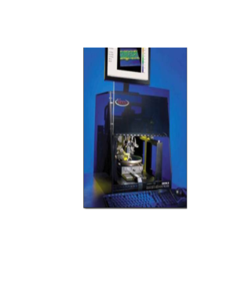
Stylus Profilometer Dektak-8
Description
The Dektak 8 profiler contains the mechanical and optical components for sample placement, sample viewing, scanning/measurement and environmental protection. A diamond- or silicontipped stylus permits accurate measurements in a wide range of applications. In standard configuration, user programmable stylus force from 1 mg to 15 mg allows profiling on soft or hard surfaces. The N-Lite Option enables programmable stylus forces down to 0.03 mg.
Specifications / Capabilities
Performs contact-based 2D or 3D topography measurement to characterize film thickness, roughness, stress and defects on samples up to 200mm Delivers 262 um vertical range with 1 Å vertical resolution at 6.55 um range Has Step Height Repeatability of 7.5 Å step, 1 sigma Allows Maximum sample thickness of 25.4mm
Link
http://brukersupport.com/ http://brukersupport.com/ProductDetail/1136
Nano-Fabrication
Center

